Slide 1
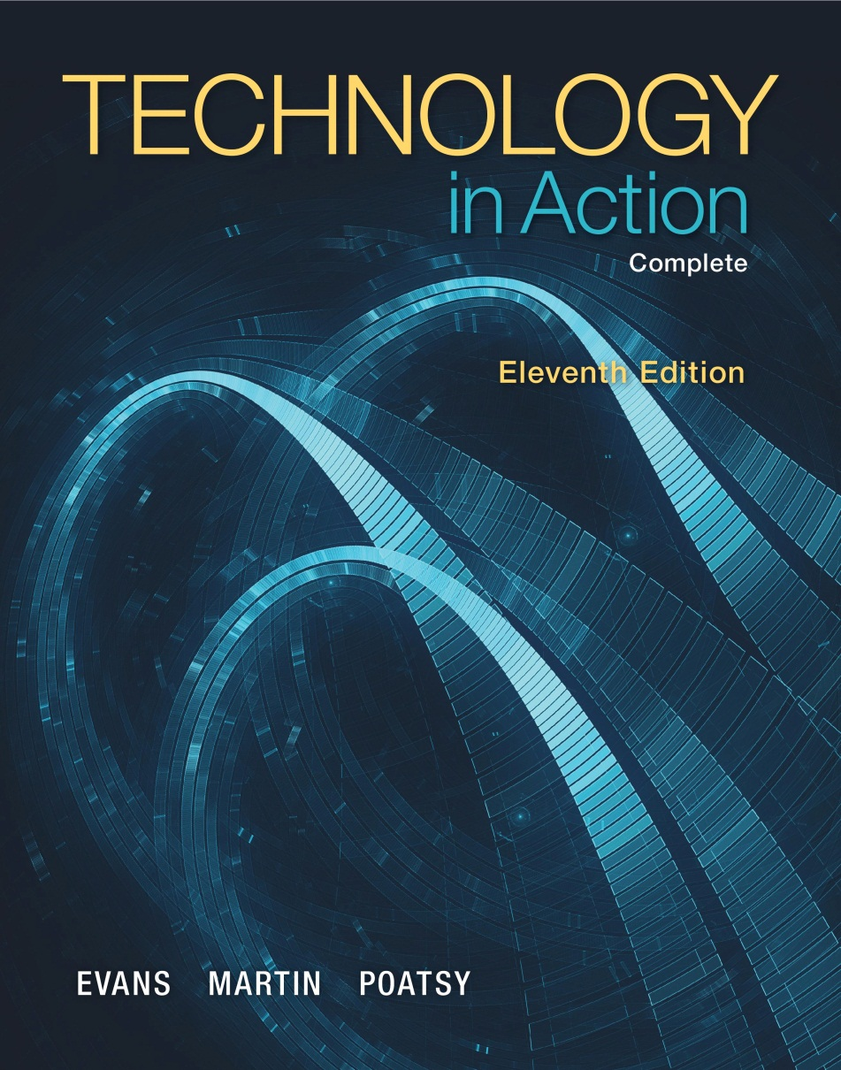
Technology in Action
Alan Evans • Kendall Martin
Mary Anne Poatsy
Eleventh Edition
Notes:
Welcome to Chapter 9: Securing Your System: Protecting Your Digital Data and Devices

Slide 2
Technology in Action
Chapter 9
Securing Your System: Protecting Your Digital Data and Devices
Notes:
This chapter covers threats to your computer such as viruses and the hardware and software we can use to help protect against them.

Slide 3
Chapter Topics
Cybercrime and Identity Theft
Protecting Yourself from Computer Viruses
Protecting Digital Assets from Hackers
Managing Online Annoyances
Keeping Your Data Safe
Protecting Your Physical Computing Assets
Notes:
Topics in this chapter include the following:
Cybercrime and Identity Theft
Protecting Yourself from Computer Viruses
Protecting Digital Assets from Hackers
Managing Online Annoyances
Keeping Your Data Safe
Protecting Your Physical Computing Assets

Slide 4
Cybercrime and Identity Theft
Cybercrime
Cybercriminals
Notes:
The media is full of stories about malicious computer programs damaging computers, criminals stealing people’s identities online, and attacks on corporate websites that have brought major corporations to a standstill. These are examples of cybercrime.
Cybercrime is any criminal action perpetrated primarily through the use of a computer. The existence of cybercrime means that computer users must take precautions to protect themselves.
Cybercriminals are individuals who use computers, networks, and the Internet to perpetrate crime. Anyone with a computer and the wherewithal to arm himself or herself with the appropriate knowledge can be a cybercriminal.

Slide 5
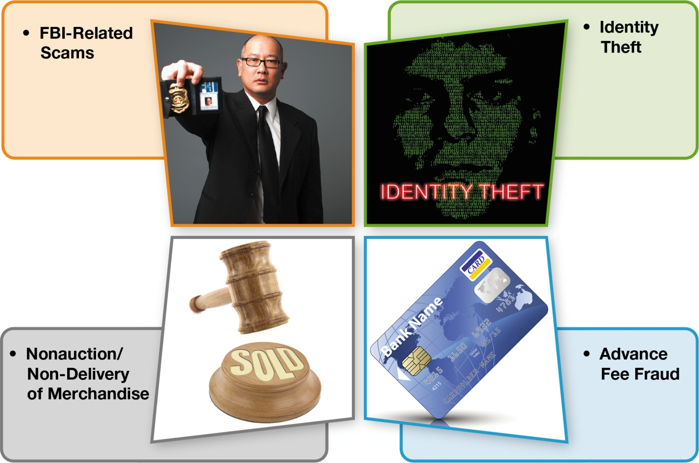
Cybercrime and Identity Theft (cont.)
Notes:
The Internet Crime Complaint Center (IC3) is a partnership between the FBI and the National White Collar Crime Center (NW3C). In 2012 (the latest year for which data was available at this book’s publication), IC3 received almost 289,000 complaints related to Internet crime.
Four common categories of complaints received were FBI-related scams, identity theft, non-auction/non-delivery of merchandise, and advance fee fraud.
Although the top four complaints all relate to some type of fraud, other complaints received involved equally serious matters such as computer intrusions (hacking), child pornography, and blackmail.

Slide 6
Cybercrime and Identity Theft (cont.)
Identity theft
Acts perpetrated by identity thieves
Notes:
Theft of personal data such as bank account numbers and credit/debit card numbers is of most concern to individuals because this information is usually used for fraudulent purposes.
Identity theft occurs when a thief steals personal information runs up debt in your name.
The nefarious acts perpetrated by identity thieves include:
Counterfeiting existing credit and debit cards
Opening new credit cards and bank accounts in your name
Obtaining medical services under your name
Buying a home with a mortgage in your name, then reselling the house and absconding with the money

Slide 7
Cybercrime and Identity Theft (cont.)
Other methods to obtain personal information
Stealing purses and wallets
Stealing mail or looking through trash
Posing as bank or credit card company representative
Skimming devices
Notes:
Many people believe that the only way your identity can be stolen is by a computer. However, the Federal Trade Commission has identified other methods thieves use to obtain others’ personal information:
Stealing purses and wallets, in which people often keep personal information such as their ATM PIN codes
Stealing mail or looking through trash for bank statements and credit card bills
Posing as bank or credit card company representatives and tricking people into revealing sensitive information over the phone
Installing skimming devices on ATM machines that record information, such as account numbers and access codes

Slide 8
Cybercrime and Identity Theft (cont.)
Theft of computer equipment
Larceny
Resale value is high
Equipment sold online
Notes:
Although theft of computer equipment is not classified as cybercrime (it is considered larceny), the theft of tablets, cell phones, notebook computers, and other portable computing devices is on the rise.
The resale value for used electronic equipment is high, and the equipment can be easily sold online.

Slide 9
Computer Viruses
Not just limited to computer
One of the most widespread types of cybercrimes
Notes:
A computer virus is a computer program that attaches itself to another computer program and attempts to spread to other computers when files are exchanged.
Creating and disseminating computer viruses is one of the most widespread types of cybercrimes. Many viruses are now designed to gather sensitive information such as credit card numbers.
Viruses are not just limited to computes; Smartphones, tablet computers, and other devices can be infected with viruses.
Even Apple users needs to worry about viruses. As the OS X and iOS operating systems have gained market share, the number of virus attacks is on the rise.

Slide 10
Computer Viruses (cont.)
Main purpose
Replicate themselves and copy
Secondary objectives
Slow down networks
Display annoying messages
Destroy files or contents of hard drive
Notes:
A computer virus’s main purpose is to replicate itself and copy its code into as many other host files as possible.
Although there might be a virus in a file on your computer, a virus normally can’t infect your computer until the infected file is opened or executed.
Although virus replication can slow down networks, it’s not usually the main threat.
The majority of viruses have secondary objectives or side effects, ranging from displaying annoying messages on the computer screen to destroying files or the contents of entire hard drives.

Slide 11
Computer Viruses (cont.)
Sources of virus infection
Downloading infected audio and video files
Shared flash drives
Downloading or executing e-mail attachments
Notes:
If your computer is exposed to a file infected with a virus, the virus will try to copy itself and infect a file on your computer.
Downloading infected audio and video files from peer-to-peer file sharing sites is a major source of virus infections.
Shared flash drives are also a common source of virus infection, as is e-mail.
Just opening an e-mail message won’t usually infect your computer, although some new viruses are launched when viewed in the preview pane. Downloading or executing an e-mail attachment are common ways that infect your computer.

Slide 12
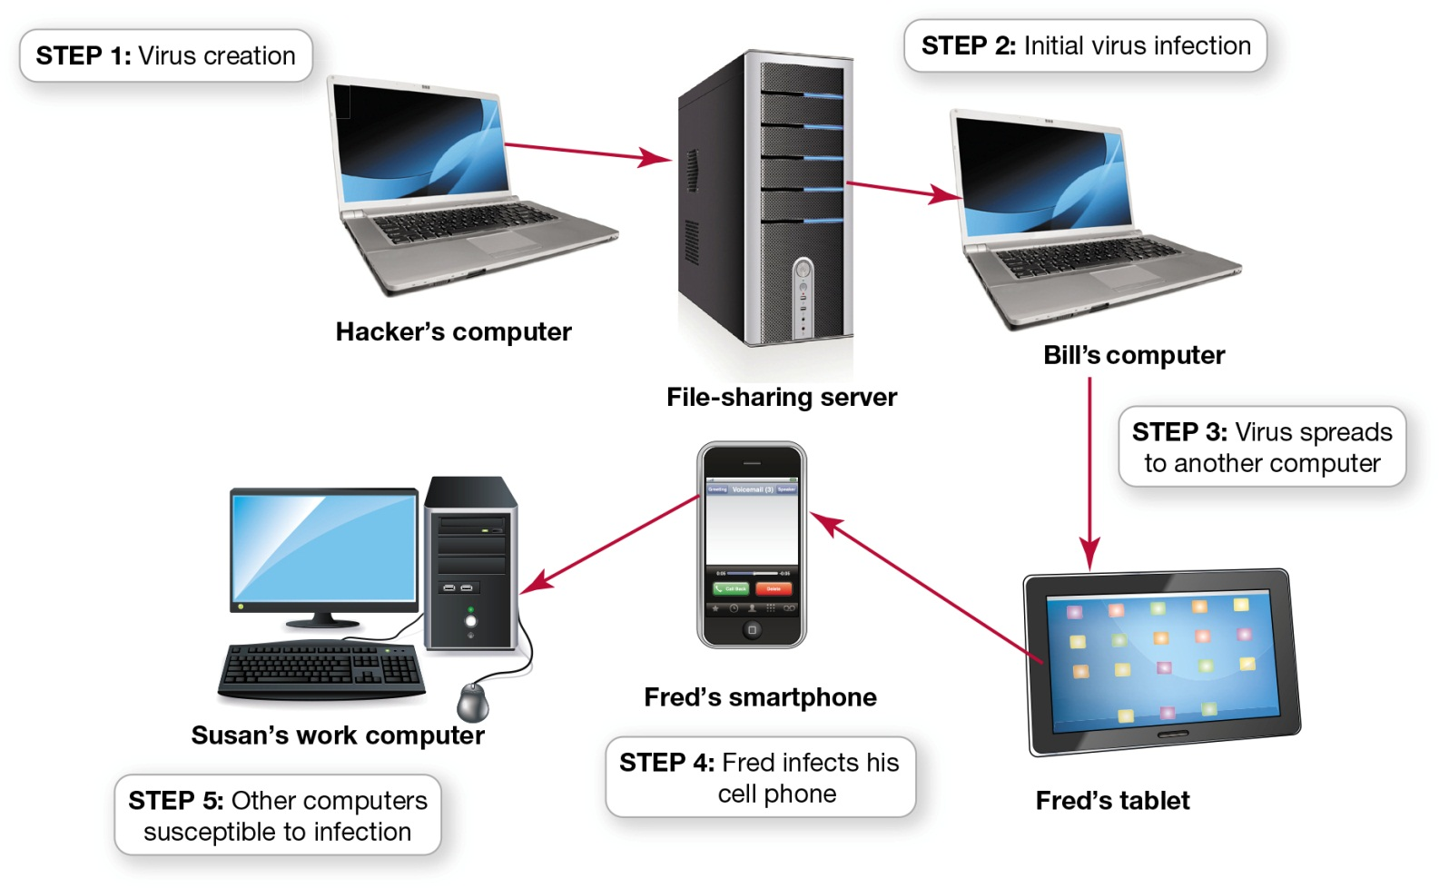
Computer Viruses (cont.)
Notes:
This figure illustrates the steps by which computer viruses are often passed from one computer to the next:
An individual writes a virus program, attaches it to a music file, and posts the file to a file-sharing site.
Bill downloads the file and infects his computer.
He sends an e-mail with the infected file and contaminates Fred’s tablet.
Fred syncs his phone with his tablet and infects his phone.
Fred e-mails the file from his phone to Susan. Everyone who copies files from Susan’s infected work computer, or whose computer is networked with Susan’s computer, risks spreading the virus.

Slide 13
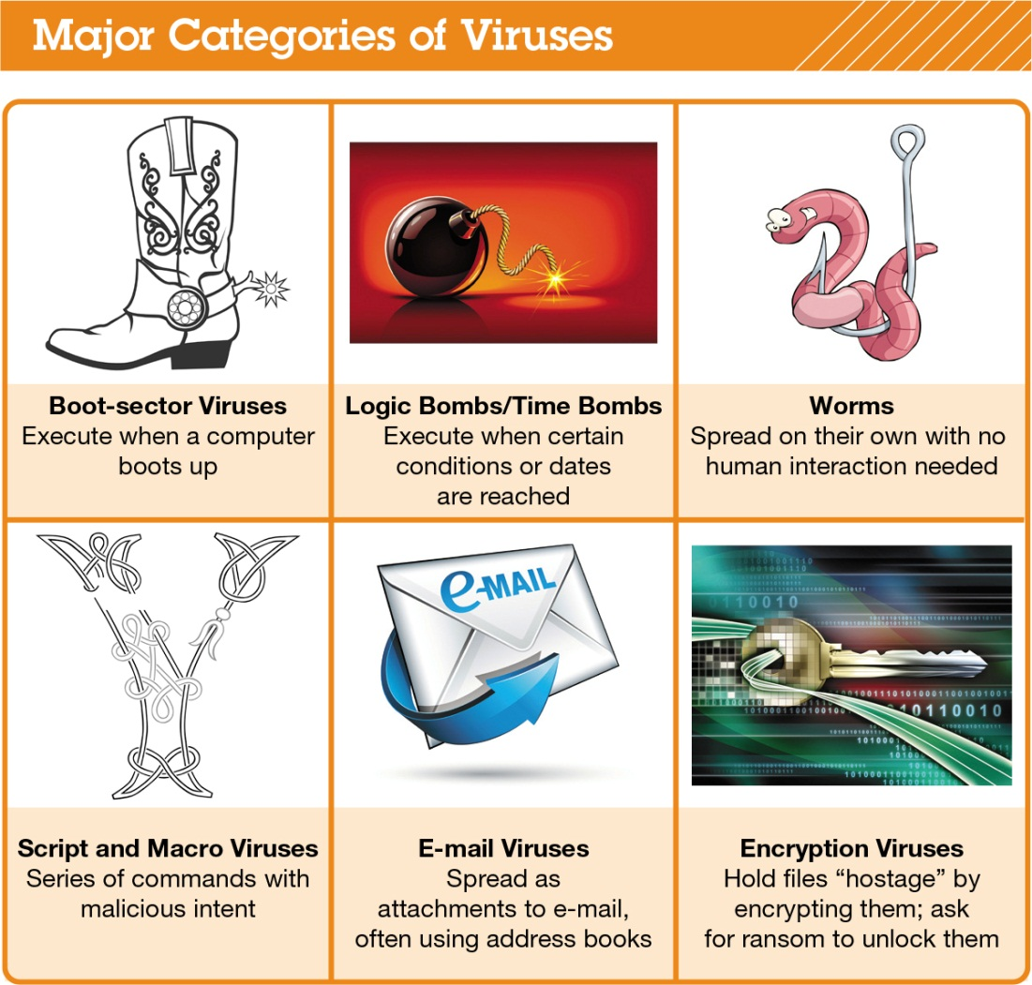
Computer Viruses (cont.)
Notes:
Although thousands of computer viruses and variants exist, they can be grouped into six broad categories based on their behavior and method of transmission.
This figure summarizes the major categories of viruses.

Slide 14
Computer Viruses: Boot-Sector Viruses
Replicates onto hard drive’s master boot record
Often transmitted by a flash drive
Notes:
A boot-sector virus replicates itself onto a hard drive’s master boot record. The master boot record is a program that executes whenever a computer boots up, ensuring that the virus will be loaded into memory immediately, even before some virus protection programs can load. Boot-sector viruses are often transmitted by a flash drive left in a USB port. When the computer boots up with the flash drive connected, the computer tries to launch a master boot record from the flash drive, which is usually the trigger for the virus to infect the hard drive.

Slide 15
Computer Viruses: Logic Bombs and Time Bombs
Logic bomb
Time bomb
Notes:
A logic bomb is a virus that is triggered when certain logical conditions are met, such as opening a file or starting a program a certain number of times. A time bomb is a virus that is triggered by the passage of time or on a certain date.

Slide 16
Computer Viruses: Worms
File transport methods
Independent of host file
Notes:
Although often called a virus, a worm is subtly different. Viruses require human interaction to spread, whereas worms take advantage of file transport methods (e.g., e-mail or network connections) to spread on their own. A virus infects a host file and waits until that file is executed to replicate and infect a computer system. A worm, however, works independently of host file execution and is much more active in spreading itself.

Slide 17
Computer Viruses: Script and Macro Viruses
Script
Macro viruses
Notes:
Some viruses are hidden on websites in the form of scripts. A script is a series of commands—actually, a miniprogram—that is executed without your knowledge.
A macro virus is a virus that attaches itself to a document that uses macros. A macro is a short series of commands that usually automates repetitive tasks.

Slide 18
Computer Viruses: E-Mail Viruses
Melissa virus
Distribute using address book
Notes:
The Melissa virus was the first practical example of an e-mail virus.
E-mail viruses use the address book in the victim’s e-mail system to distribute the virus.

Slide 19
Computer Viruses: Encryption Viruses
Data files
Become unusable
Notes:
When encryption viruses infect your computer, they run a program that searches for common types of data files, such as Microsoft Word and Excel files, and compresses them using a complex encryption key that renders your files unusable. You then receive a message that asks you to send money to an account if you want to receive the program to decrypt your files.

Slide 20
Computer Viruses: Additional Virus Classifications
Classified by methods used to avoid detection
Polymorphic viruses
Multipartite viruses
Stealth viruses
Notes:
Viruses can also be classified by the methods they take to avoid detection by antivirus software:
A polymorphic virus changes its code to avoid detection. Most polymorphic viruses infect one particular type of file such as .EXE files.
A multipartite virus is designed to infect multiple file types in an effort to fool the antivirus software.
Stealth viruses temporarily erase their code from the files where they reside and hide in the active memory of the computer. This helps them avoid detection if only the hard drive is searched for viruses. Current antivirus software scans memory and the hard drive.

Slide 21
Computer Viruses: Virus Symptoms
Existing program icons or files suddenly disappear
Unusual home page
New toolbars
Odd messages, pop-ups, or images
Data files become corrupt
Programs stop working properly
System slows down or takes a long time to boot up
Notes:
If your computer displays any of the following symptoms, it might be infected with a virus:
Existing program icons or files suddenly disappear.
You start your browser, and it takes you to an unusual home page or it has new toolbars.
Odd messages, pop-ups, or images are displayed on the screen, or strange music or sounds play.
Data files become corrupt. However, files can become corrupt for reasons other than a virus.
Programs stop working properly, which could be caused by either a corrupted file or a virus.
Your system slows down or takes a long time to boot up.

Slide 22
Preventing Virus Infections
Antivirus software
Detects viruses and protects your computer
Popular antivirus
Symantec
Kaspersky
AVG
McAfee
Notes:
Antivirus software is specifically designed to detect viruses and protect your computer and files from harm. Symantec, Kaspersky, AVG, and McAfee are among the companies that offer highly rated antivirus software packages.
Antivirus protection is also included in comprehensive Internet security packages such as Norton Internet Security, Kaspersky Internet Security, and McAfee Total Protection. These software packages also help protect you from threats other than computer viruses.

Slide 23
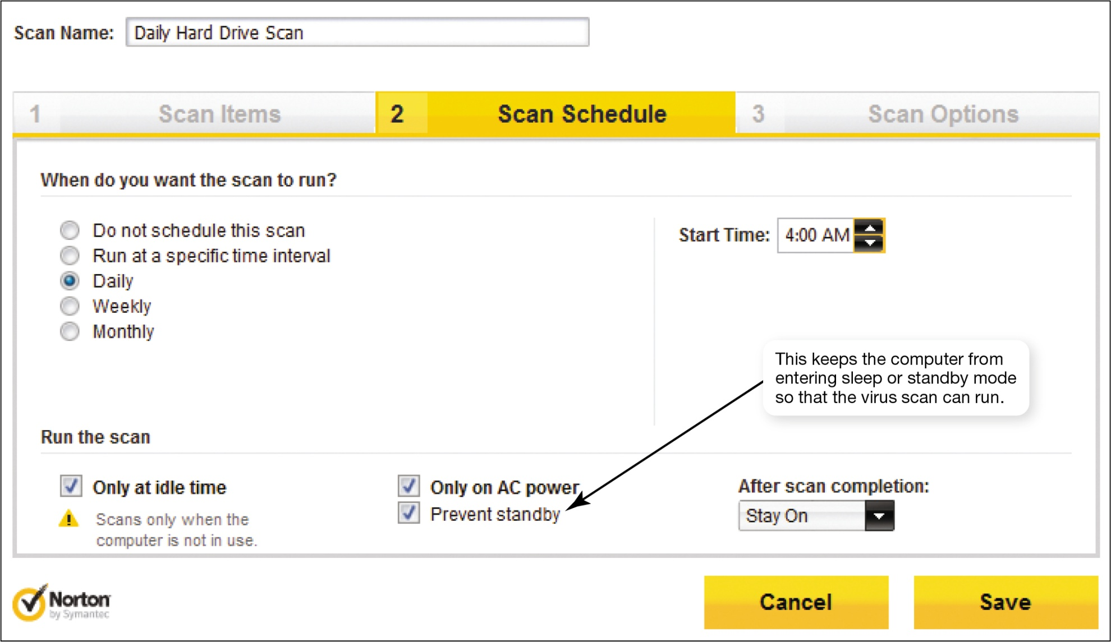
Preventing Virus Infections: Antivirus Software
Notes:
Although antivirus software is designed to detect suspicious activity on your computer at all times, you should run an active virus scan on your entire system at least once a week.
Current antivirus programs run scans in the background when your CPU is not being heavily utilized. You can also configure to run scans when you aren’t using your system. Alternatively, if you suspect a problem, you can launch a scan and have it run immediately.
In Norton Internet Security, you can set up virus scans to run automatically. This computer will be scanned every day at 4 a.m.

Slide 24
Preventing Virus Infections: Antivirus Software (cont.)
Main functions of antivirus software
Detection
Stopping virus execution
Preventing future infection
Notes:
The main functions of antivirus software are:
Detection: Antivirus software looks for virus signatures in files. A virus signature is a portion of the virus code that’s unique to a particular computer virus.
Stopping virus execution: If the antivirus software detects a virus signature, it stops the execution of the file and virus and notifies you. It also places the virus in a secure area on your hard drive; known as quarantining.
Prevention of future infection: In inoculation, the antivirus software records key attributes about your computer files and keeps these statistics in a safe place on your hard drive.

Slide 25
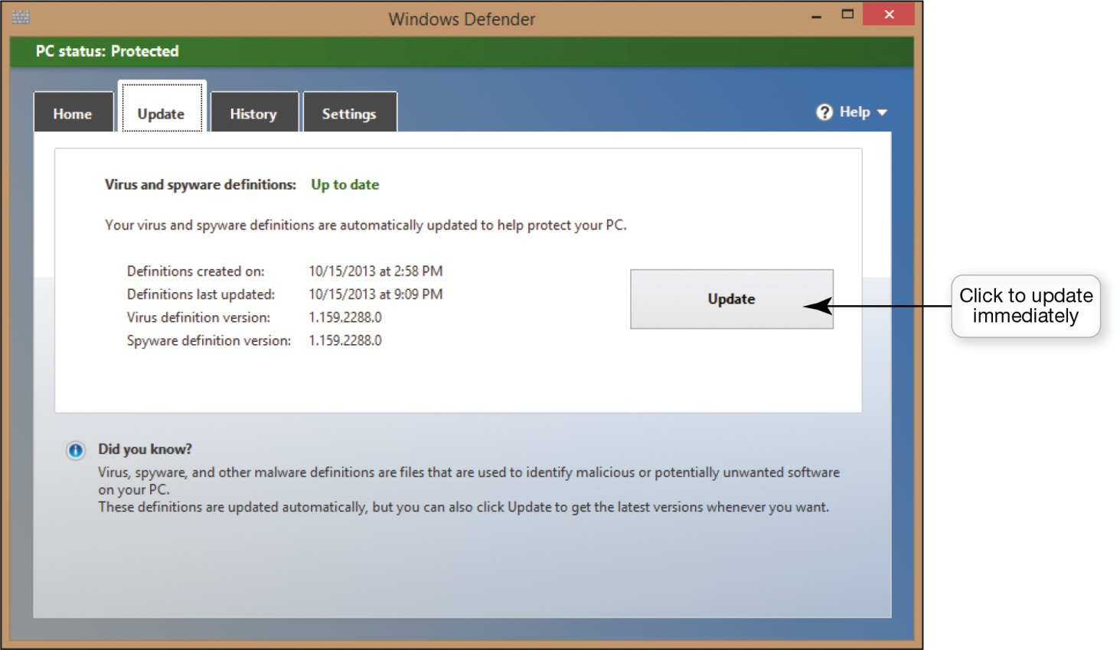
Preventing Virus Infections: Antivirus Software (cont.)
Notes:
Most new computers do come with antivirus software preinstalled. However, these are usually trial versions of the software that only provide updates to the software for a limited period of time, usually 90 or 180 days.
Most antivirus programs have an automatic update feature that downloads updates for virus signature files every time you go online.
Also, the antivirus software usually shows the status of your update subscription so that you can see how much time you have remaining until you need to buy another version of your software.

Slide 26
Preventing Virus Infections: Antivirus Software (cont.)
If computer is infected
Boot up using antivirus installation disc
Virus is detected
Research it
Websites contain archives on viruses
Notes:
If you think your computer is infected with a virus, boot up your computer using the antivirus installation disc. This should prevent most virus programs from loading and allow you to run the antivirus software directly from your disk drive.
If the software does detect viruses, you might want to research them further to determine whether your antivirus software will eradicate them completely or whether you’ll need to take additional manual steps to eliminate the viruses.
Most antivirus company websites, such as the Symantec site, contain archives of information on viruses and provide step-by-step solutions for removing them.

Slide 27
Preventing Virus Infections: Antivirus Software (cont.)
Smartphones and other mobile devices are susceptible to viruses
Antivirus software for mobile devices
Trend Micro’s Mobile Security for Android
Notes:
Because smartphones and other mobile devices run operating systems and contain files, they are susceptible to infection by viruses. Cybercriminals are now hiding viruses in legitimate-looking apps for download to mobile devices.
Most antivirus software companies now offer antivirus software specifically designed for mobile devices, such as Lookout Mobile Security, which Samsung is now installing on its Android phones.

Slide 28
Preventing Virus Infections: Software Updates
Drive-by download
Windows operating system
Automatic update utility: Windows Update
Notes:
Many viruses exploit weaknesses in operating systems. Malicious websites can be set up to attack computers by downloading harmful software.
According to research conducted by Google, this type of attack, known as a drive-by download, affects almost 1 in 1,000 web pages.
To combat these threats, make sure your OS is up to date and contains the latest security patches. You can update your Windows OS with an automatic update utility called Windows Update. When it is enabled, your computer searches for updates every time it connects to the Internet. Mac OS X has a similar utility for gathering updates.

Slide 29
Preventing Virus Infections: Software Updates (cont.)
Default option in Windows
Receive updates automatically
Other options available
Notes:
The default option in Windows is to receive updates automatically. There are several other options you can choose from in Windows.
The following are noteworthy:
Option 1: Install updates automatically.
Option 2: Check for updates but let me choose whether to download and install them.
Option 3: Give me recommended updates.
Option 4: Microsoft Update. This option ensures you receive updates for other Microsoft products besides Windows.
If you keep both your antivirus and OS software up to date, you’ll help prevent viruses from infecting your computer.

Slide 30
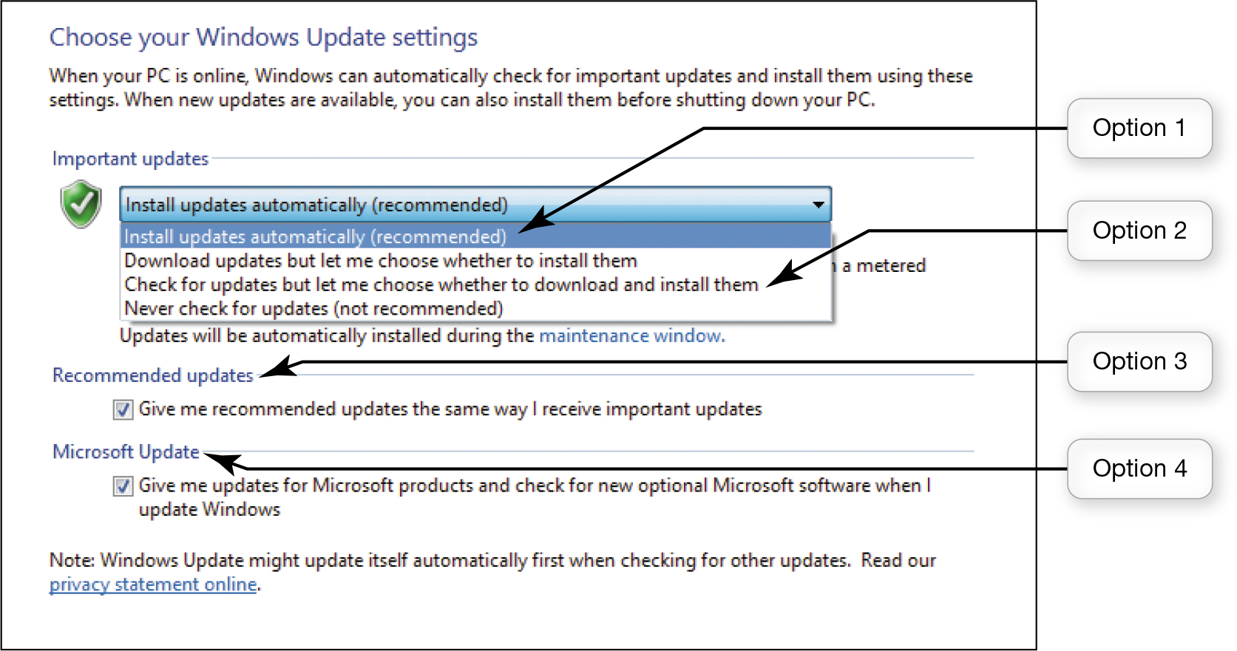
Preventing Virus Infections: Software Updates (cont.)
Notes:
The Windows Update screen makes it easy for users to configure Windows to update itself.
To enable automatic updates, access the Control Panel, select System and Security, click the Windows Update link, and then click the Change Settings link.

Slide 31
Hackers
Types of hackers
White-hat or ethical hackers
Black-hat hackers
Grey-hat hackers
Notes:
A hacker is most commonly defined as anyone who unlawfully breaks into an individual or network computer system.
Some hackers are offended by being labeled as criminals and therefore attempt to classify different types of hackers, as follows:
White-hat hackers (or ethical hackers) break in to systems for nonmalicious reasons.
Black-hat hackers break into systems to destroy information or for illegal gain.
Grey-hat hackers often break into systems merely to flaunt their expertise.
Regardless of the hackers’ opinions, the laws in the United States and many other countries consider any unauthorized access to computer systems a crime.

Slide 32
Hackers: Problems Hackers Can Cause
Steal credit and debit card information
Break into sites
Capture login ID and password
Notes:
Hackers often try to break into computers or websites that contain credit card information. If you perform financial transactions online, credit card and bank account information can reside on your hard drive or an online business’s hard drive and could be detectable by a hacker.
Many sites require that you provide a login ID and password to gain access. Even if this data is not stored on your computer, a hacker might be able to capture it when you’re online by using a packet analyzer (sniffer) or a keylogger (a program that captures all keystrokes made on a computer).

Slide 33
Hackers: Problems Hackers Can Cause (cont.)
Packet analyzer (sniffer)
Firewall
Data encryption
Notes:
A packet analyzer (sniffer) is a program deployed by hackers that looks at each packet as it travels on the Internet.
A hacker might sit in a coffee shop and run a packet sniffer to capture sensitive data from patrons using the coffee shop’s free wireless network.
If hackers can gather enough information, they might be able to commit identity theft.
You can easily protect yourself from packet sniffing by installing a firewall and using data encryption on a wireless network.

Slide 34

Hackers: Trojan Horses and Rootkits
Trojan Horses—appear to be useful
Rootkits
Zombie
Notes:
A Trojan horse is a program that appears to be something useful or desirable but it does something malicious in the background without your knowledge.
Often, the malicious activity perpetrated is the installation of a backdoor program or a rootkit that allow hackers to gain access to your computer and take almost complete control of it.
Using a backdoor program, hackers can access and delete the files, send e-mail, run programs, and do about anything else. A computer that is controlled in this manner is referred to as a zombie and is often used to launch denial-of-service attacks.

Slide 35
Hackers: Denial-of-Service Attacks
Users are denied access to a computer system
System shuts down
Notes:
In a denial-of-service (DoS) attack, legitimate users are denied access to a computer system because a hacker is repeatedly making requests of that computer system through a computer he or she has taken over as a zombie. A computer can handle only a certain number of requests for information at one time. When it is flooded with requests in a DoS attack, it shuts down and refuses to answer any requests for information, even if the requests are from a legitimate user. The computer is so busy responding to the bogus requests for information that authorized users can’t gain access.

Slide 36
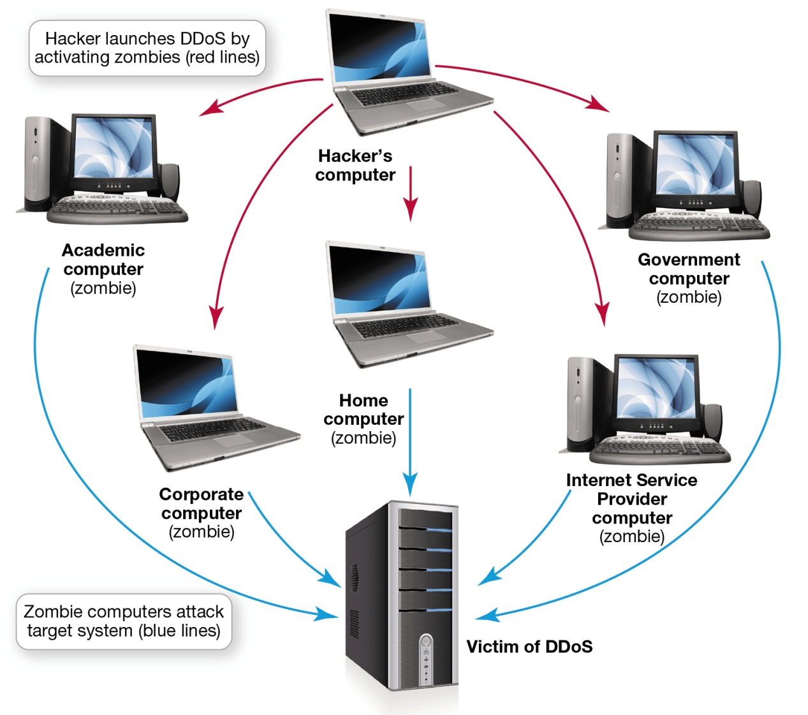
Hackers: Denial-of-Service Attacks (cont.)
Notes:
Launching a DoS attack on a computer system from a single computer system from a single user is easy to trace. Most hackers use a distributed denial-of-service (DDoS) attack, which launches attacks from more than one zombie at the same time.
Administrators of the victim computer often have a great deal of difficulty stopping the attack because it comes from so many computers. Often, the attacks are coordinated automatically by botnets—a large group of software programs that run autonomously on zombie computers.
Because many websites receive revenue from users DDoS attacks can be financially distressing for the affected websites.

Slide 37
Hackers: How Hackers Gain Computer Access
Direct access
Indirect access
Logical ports
Notes:
Hackers can gain access to computers directly or indirectly:
Direct access involves sitting down at a computer and installing hacking software. It is unlikely that such an attack would occur in your home, but it’s always a wise precaution to set up your computer so that it requires a password for a user to gain access.
The most likely method a hacker will use to access a computer is to enter indirectly through its Internet connection.
Logical ports are virtual communications gateways that allow a computer to organize requests for information.
Logical ports are numbered and assigned to specific services.

Slide 38
Restricting Access to Your Digital Assets
Keep hackers out
Prevent them from accessing computer
Protect your digital information
Hide activities from prying eyes
Notes:
Keeping hackers at bay is often just a matter of keeping them out. You can achieve this by:
Preventing hackers from accessing your computer (usually through your Internet connection)
Protecting your digital information in such a way that it can’t be accessed (e.g., by using passwords)
Hiding your activities from prying eyes
In the next section, we explore strategies for protecting access to your digital assets and keeping your Internet surfing activities from being seen by the wrong people.

Slide 39
Restricting Access to Your Digital Assets: Firewalls
Firewall
Personal firewall
Windows and OS X include firewalls
Security suites include firewall software
Notes:
A firewall is a software program or hardware device designed to protect computers from hackers.
A firewall specifically designed for home networks is called a personal firewall.
Both hardware and software firewalls will protect you from hackers.
Both Windows and OS X include reliable firewalls. The Windows Action Center is a good source of information about the security settings on your computer, including the status of your firewall.
Security suites such as Norton Internet Security, McAfee Internet Security, and ZoneAlarm Internet Security Suite also include firewall software.

Slide 40
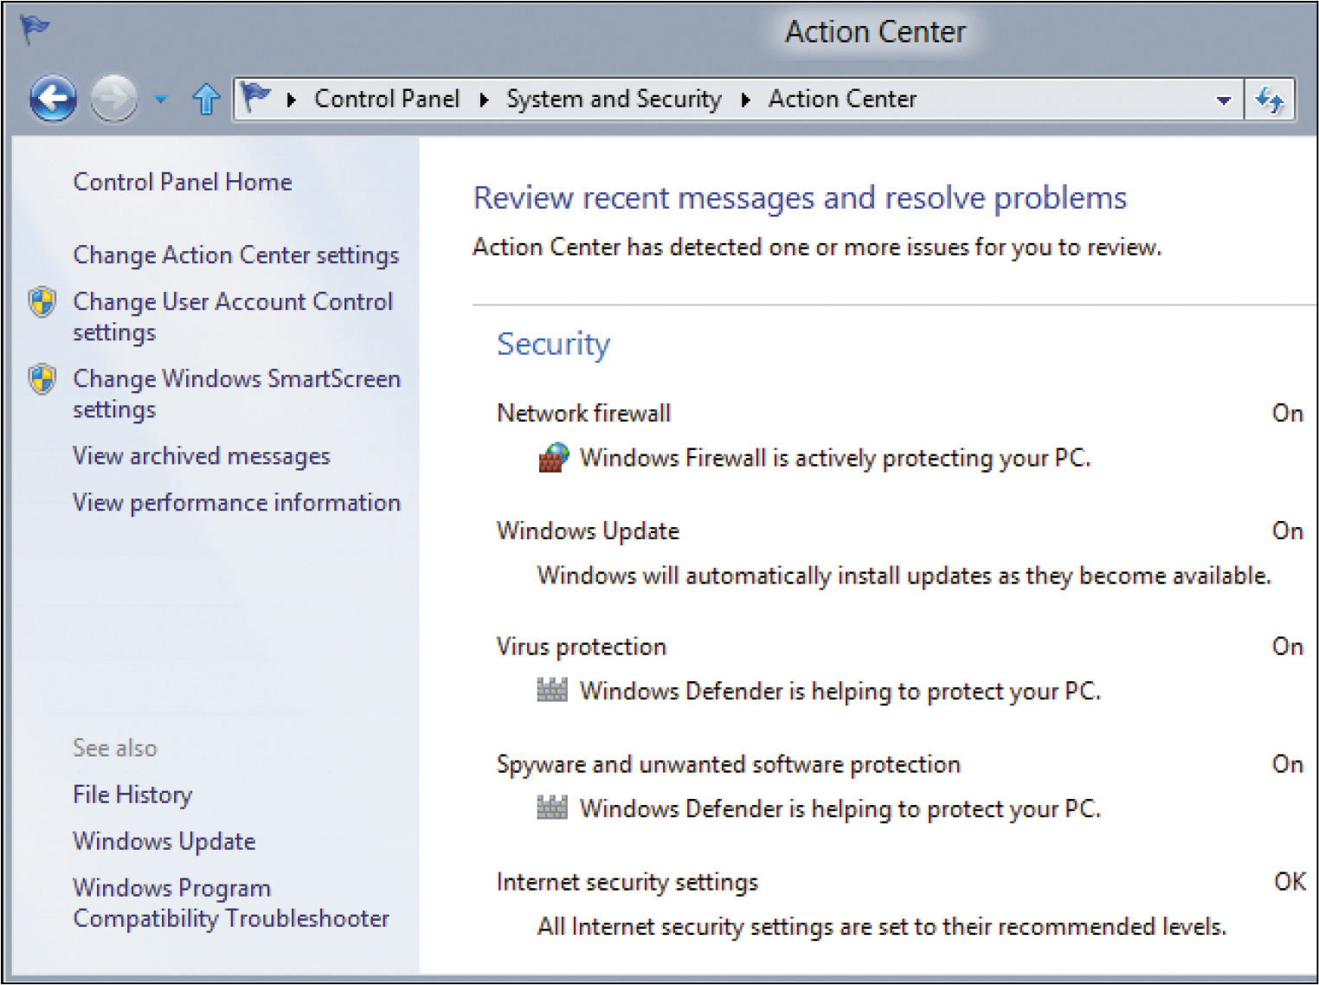
Restricting Access to Your Digital Assets: Firewalls (cont.)
Notes:
The security section of the Windows Action Center provides the status of programs protecting your computer.
To view the Action Center, access the Control Panel, select System and Security, and then click the Action Center link.

Slide 41
Restricting Access to Your Digital Assets: How Firewalls Work
Protect in two major ways
Blocking access to logical ports
Keeping computer’s network address secure
Packet filtering
Logical port blocking
Notes:
Firewalls protect you in two major ways:
By blocking access to logical ports
By keeping your computer’s network address secure
To block access to logical ports, firewalls examine data packets that your computer sends and receives.
Firewalls can be configured so that they filter out packets sent to specific logical ports in a process known as packet filtering.
Firewalls are also configured to ignore requests that originate from the Internet asking for access to certain ports. This process is referred to as logical port blocking. By using filtering and blocking, firewalls keep hackers from accessing your computer.

Slide 42
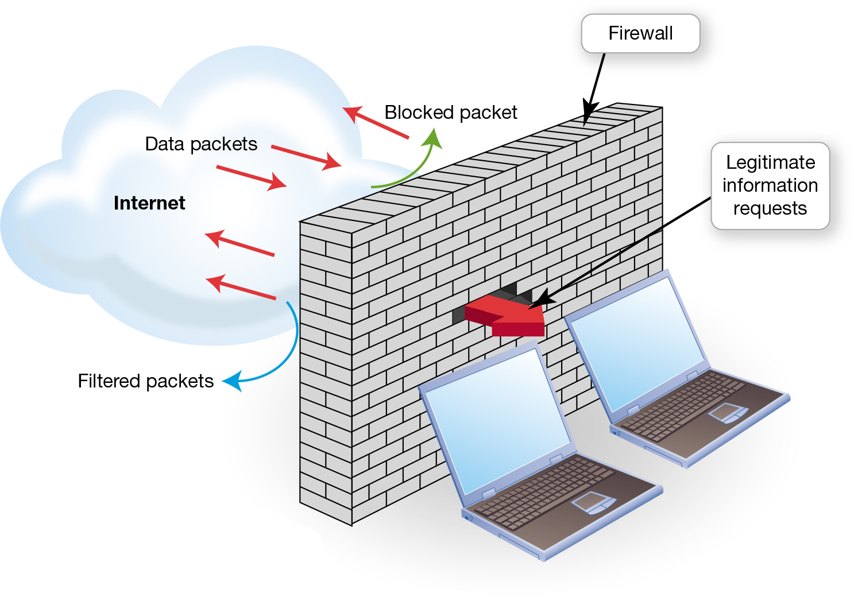
Restricting Access to Your Digital Assets: How Firewalls Work (cont.)
Notes:
Firewalls use filtering and blocking to keep out unwanted data and keep your network safe.

Slide 43
Restricting Access to Your Digital Assets: How Firewalls Work (cont.)
Internet Protocol address (IP address)
Network address translation (NAT)
Notes:
Every computer connected to the Internet has a unique address called an Internet Protocol (IP) address.
If a hacker finds out the IP address of your computer, he or she can locate it on the Internet and try to break into it.
Firewalls use a process called network address translation (NAT) to assign internal IP addresses on a network.
Internal IP addresses are used only on the internal network and can’t be detected by hackers.
With a NAT-capable router/firewall, hackers are unable to access the internal IP address assigned to your computer.

Slide 44
Restricting Access to Your Digital Assets: Knowing Your Computer Is Secure
Websites test computer’s vulnerability
Gibson Research
ShieldsUP
LeakTest
If vulnerabilities are detected:
Install a firewall
Close or restrict access to ports
Notes:
For peace of mind you can visit several websites that offer free services that test your computer’s vulnerability. One popular site is Gibson Research (www.grc.com). The company’s ShieldsUP and LeakTest programs are free and easy to run and can pinpoint security vulnerabilities in a system that is connected to the Internet.
If the testing program detects vulnerabilities and you don’t have a firewall, you should install one. If the firewall is already configured and common ports are identified as being vulnerable, consult your firewall documentation for instructions on how to close or restrict access to those ports.

Slide 45
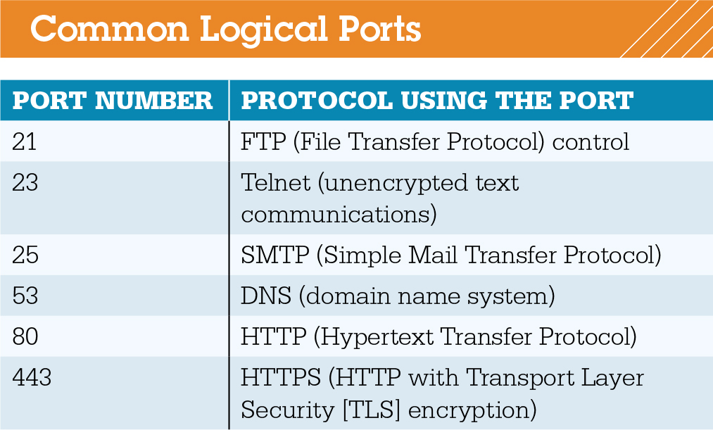
Restricting Access to Your Digital Assets: Knowing Your Computer Is Secure (cont.)
Notes:
If the firewall is already configured and common ports are identified as being vulnerable, consult your firewall documentation for instructions on how to close or restrict access to those ports.

Slide 46
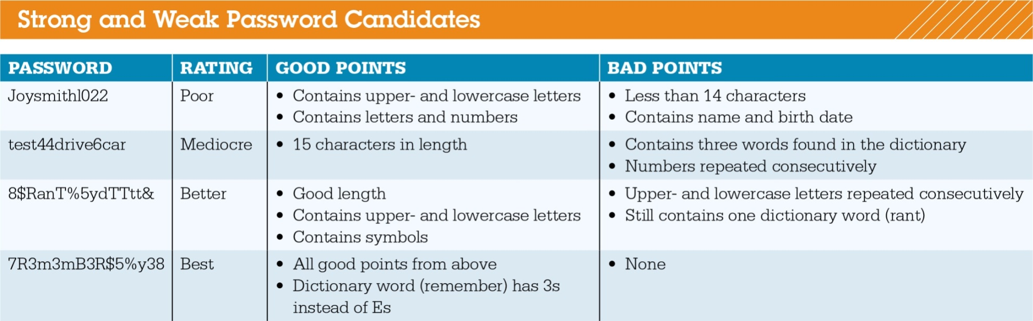
Restricting Access to Your Digital Assets: Creating Passwords (cont.)
Notes:
Follow these guidelines to create strong passwords:
Don’t use easily deduced components related to your life.
Use a password that is at least 14 characters long.
Don’t use words found in the dictionary.
Use a mix of upper- and lowercase letters and symbols.
Never tell anyone your password or write it down in a place where others might see it.
Change your passwords on a regular basis.
Don’t use the same password for every account you have.
If you have trouble thinking of secure passwords, there are many password generators available for free, such as the Strong Password Generator.

Slide 47
Restricting Access to Your Digital Assets: Creating Passwords (cont.)
Password strength tests
Password Meter
Operating systems have built-in password protection
Windows 8
Picture passwords
Notes:
You can use online password strength testers, such as the Password Meter, to evaluate your passwords.
To restrict access to your computer, Windows, OS X, and most other operating systems have built-in password (or passcode) protection for files as well as the entire desktop.
Windows 8 allows you to use picture passwords. You select a picture, then draw three gestures on it: either straight lines, circles, or taps. This picture then works as an additional method for accessing your computer. You just unlock your computer by repeating the gestures.

Slide 48
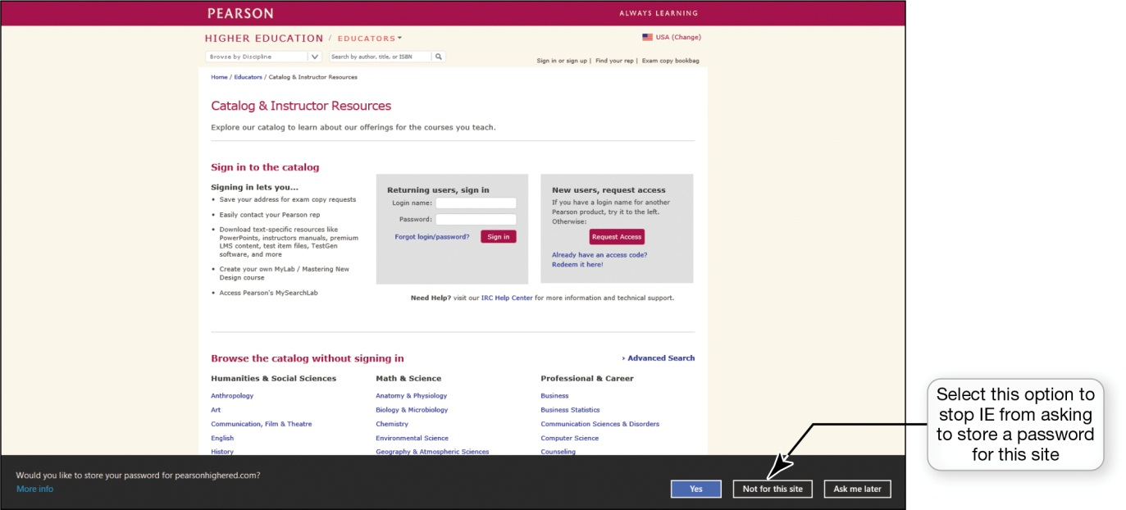
Restricting Access to Your Digital Assets: Managing Your Passwords (cont.)
Password management software
Security suites and web browsers provide password management tools
Notes:
Good security practices suggest that you have different passwords for all the different websites that you access and that you change your passwords frequently.
Password management tools are now widely available. The password management software does the remembering for you.
Most current Internet security suites and web browsers make it easy to keep track of passwords by providing password management tools.
Internet Explorer (IE) will remember passwords for you. There are some passwords that you shouldn’t have your browser remember, such as your online banking password.

Slide 49
Restricting Access to Your Digital Assets: Anonymous Web Surfing: Hiding from Prying Eyes
Privacy tools to surf the web anonymously
Incognito
Private Browsing
InPrivate
Notes:
The current versions of Google Chrome, Firefox, and Internet Explorer include privacy tools (called Incognito, Private Browsing, and InPrivate, respectively) that help you surf the web anonymously. When you choose to surf anonymously, all three browsers open special versions of their browser windows that are enhanced for privacy. When surfing in these windows, records of websites you visit and files you download don’t appear in the web browser’s history files. Furthermore, any temporary files that were generated in that browsing session are deleted when you exit the special window.

Slide 50
Restricting Access to Your Digital Assets: Anonymous Web Surfing: Hiding from Prying Eyes (cont.)
Portable privacy devices
Ironkey Personal Flash Drive
Store sensitive Internet files
Preload Linux OS on a flash drive
Notes:
Portable privacy devices, such as the Ironkey Personal Flash Drive, provide an even higher level of surfing privacy. Simply plug the device into a port.
All sensitive Internet files will be stored on the device, not on the computer.
Privacy devices often come preloaded with software designed to shield your IP address. These privacy devices also have password management tools that store all of your login information and encrypt it so it will be safe.
Another free practical solution is to take the Linux OS with you on a flash drive and avoid using the public or work computer’s OS.

Slide 51
Restricting Access to Your Digital Assets: Anonymous Web Surfing: Hiding from Prying Eyes (cont.)
Third-party software developers offer apps to enhance tablet security
IPVanish
Notes:
Tablets like the iPad run their own proprietary operating systems. Although tablet operating systems do contain security features, they might not be robust enough to satisfy business users who have a great deal of confidential information on their tablets, especially when the devices are connected to wireless networks.
Third-party software developers are now offering security apps. Comprehensive suites like IPVanish offer features such as government-grade encryption of data, enhanced e-mail security, and anonymous web surfing. Look for security apps that are specifically designed for tablet devices if you often deal with sensitive data on your tablet, such as online banking.

Slide 52
Restricting Access to Your Digital Assets: Biometric Authentication Devices
Fingerprint
Iris pattern in eye
Voice authentication
Face pattern recognition
Provide high level of security
Notes:
A biometric authentication device reads a unique personal characteristic such as a fingerprint or the iris pattern in your eye and converts it to a digital code.
The device reads your pattern and compares it with the one stored on the computer.
Because no two people have the same biometric characteristics these devices provide a high level of security.
They also eliminate the human error that can occur in password protection.
Other biometric devices, including voice authentication and fingerprint-recognition systems, are now widely offered in notebook computers, tablets, and smartphones.

Slide 53
Managing Online Annoyances: Malware: Adware and Spyware
Malware
Three primary forms
Adware
Spyware
Viruses
Notes:
Malware is software that has a malicious intent (hence the prefix mal). There are three primary forms of malware: adware, spyware, and viruses. Adware and spyware are not physically destructive like viruses and worms, which can destroy data.
Known collectively as grayware, most malware is intrusive, annoying, or objectionable online programs that are downloaded to your computer when you install or use other online content such as a free program, game, or utility.
Adware is software that displays sponsored advertisements in a section of your browser window or as a pop-up box.

Slide 54
Managing Online Annoyances: Malware: Adware and Spyware (cont.)
Spyware
Transmits information
Tracking cookies
Keystroke logger
Anti-spyware software
Install one or two additional standalone anti-spyware programs
Notes:
Spyware is an unwanted piggyback program that downloads with other software you install from the Internet and runs in the background of your system.
Spyware transmits information about you to the owner of the program.
One type of spyware program known as a keystroke logger (key logger) monitors keystrokes with the intent of stealing passwords, login IDs, or credit card information.
Anti-spyware software detects unwanted programs and allows you to delete the offending software easily.
It is a good idea to install one or two additional anti-spyware programs on your computer.
You should update and run your anti-spyware software regularly.

Slide 55
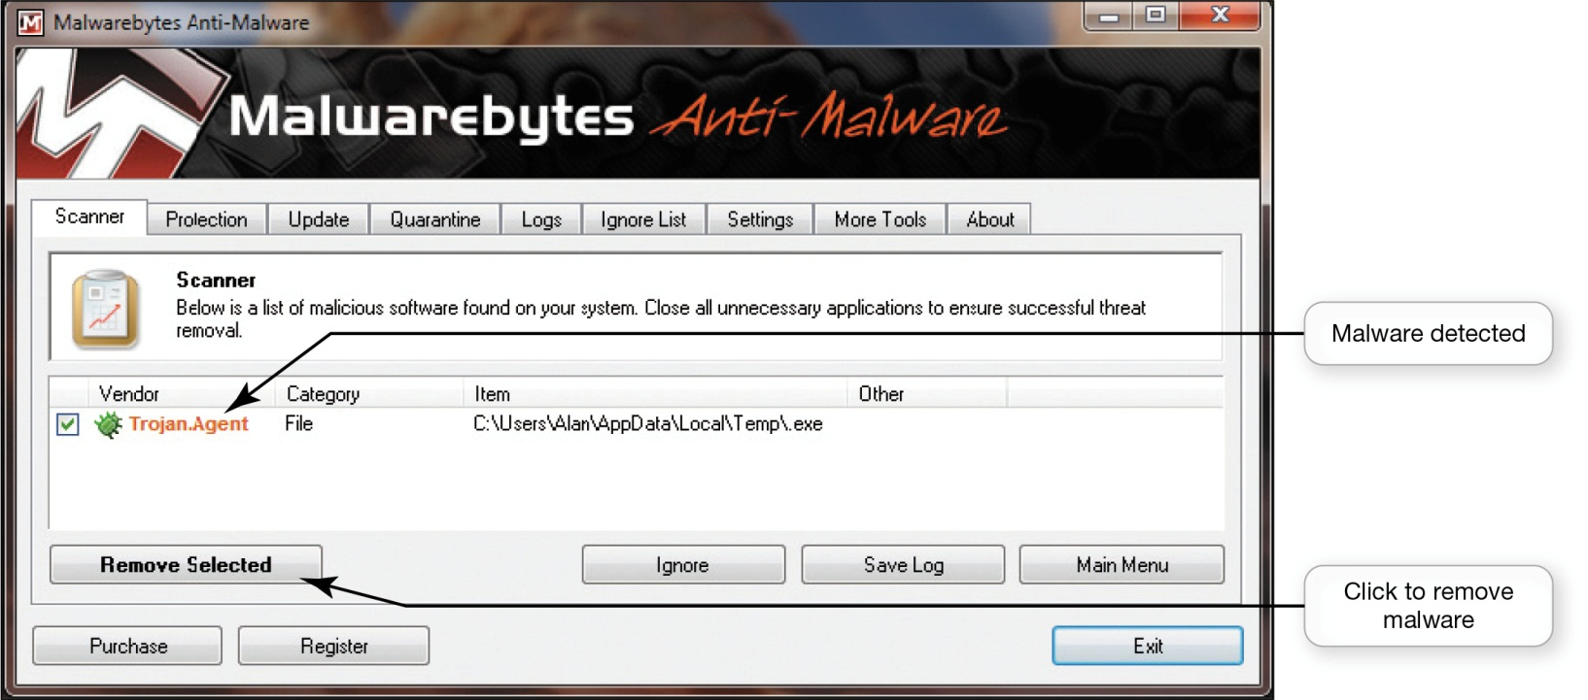
Managing Online Annoyances: Malware: Adware and Spyware (cont.)
Windows Defender
Malwarebytes Anti-Malware, Ad-Aware, and Spybot
Notes:
Windows comes with a program called Windows Defender, which scans your system for spyware and other potentially unwanted software.
Malwarebytes Anti-Malware, Ad-Aware, and Spybot-Search & Destroy are other anti-spyware programs that are easy to install and update.

Slide 56
Managing Online Annoyances: Spam
Spam
Spim
Use a free e-mail address
Notes:
Companies that send out spam—unwanted or junk e-mail—find your e-mail address either from a list they purchase or with software that looks for e-mail addresses on the Internet.
Unsolicited instant messages are also a form of spam, called spim.
One way to avoid spam in your primary account is to create a free e-mail address that you use only when you fill out forms or buy items on the web. If your free e-mail account is saturated with spam, you can abandon that account with little inconvenience.

Slide 57
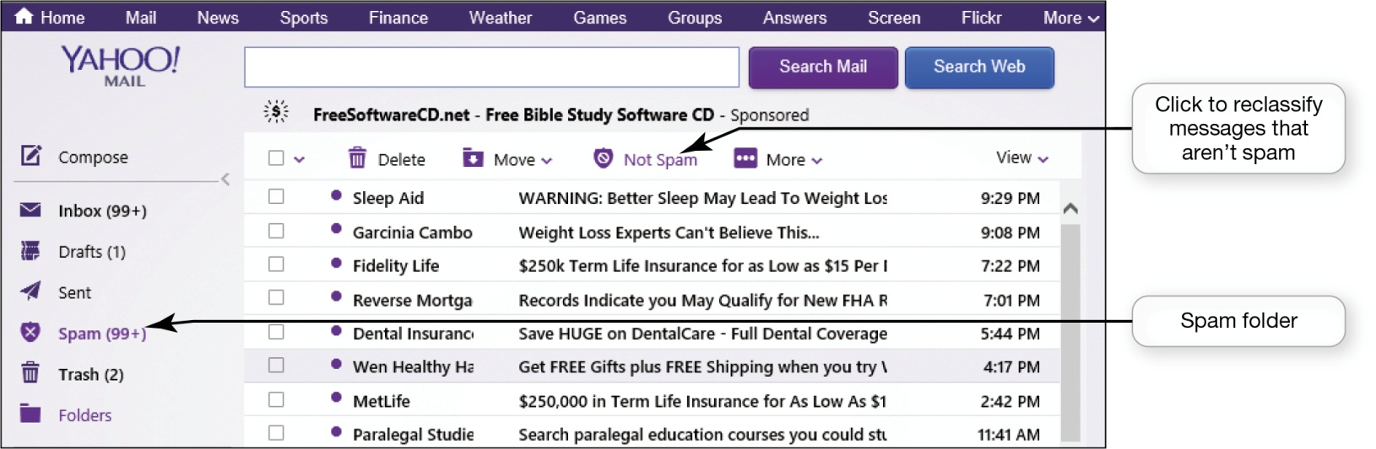
Managing Online Annoyances: Spam (cont.)
Spam filter
Third-party programs available
SPAMfighter
Notes:
A spam filter is an option you can select in your e-mail account that places known or suspected spam messages into a special Spam or Junk Mail folder. Most web-based e-mail services, such as Hotmail and Yahoo!, offer spam filters. Microsoft Outlook also features a spam filter.
Spam filters and filtering software can catch as much as 95% of spam by checking incoming e-mail subject headers and senders’ addresses against databases of known spam.
Spam filters check your e-mail for frequently used patterns and keywords.
Most programs let you reclassify e-mails that have been misidentified as spam.

Slide 58
Managing Online Annoyances: Spam (cont.)
Other ways to prevent spam
Read website privacy policies
Don’t give the site permission to pass on your e-mail address
Don’t reply to spam
Subscribe to an e-mail forwarding service
Notes:
Here are a few other ways you can prevent spam:
Before registering on a website, read its privacy policy to see how it uses your e-mail address. Don’t give the site permission to pass on your e-mail address to third parties.
Don’t reply to spam to remove yourself from the spam list. By replying, you’re confirming that your e-mail address is active. Instead of stopping spam, you might receive more.
Subscribe to an e-mail forwarding service such as VersaForward or Sneakemail.com. These services screen your e-mail messages, forwarding only those messages you designate as being okay to accept.

Slide 59
Managing Online Annoyances: Cookies
Provide websites with information about browsing habits
Don’t search for personal information
Only collect information you supply when filling out forms
Some sites sell the information
Pose no security threat
Notes:
Cookies are small text files that some websites automatically store on your hard drive when you visit them.
Cookies can provide websites with information about your browsing habits.
The only personal information a cookie obtains is the information you supply when you fill out forms online.
Some sites sell the personal information their cookies collect. Cookies pose no security threat because it is virtually impossible to hide a virus or malicious software program in a cookie.
Deleting your cookie files could actually cause you the inconvenience of reentering data you have already entered into website forms.

Slide 60
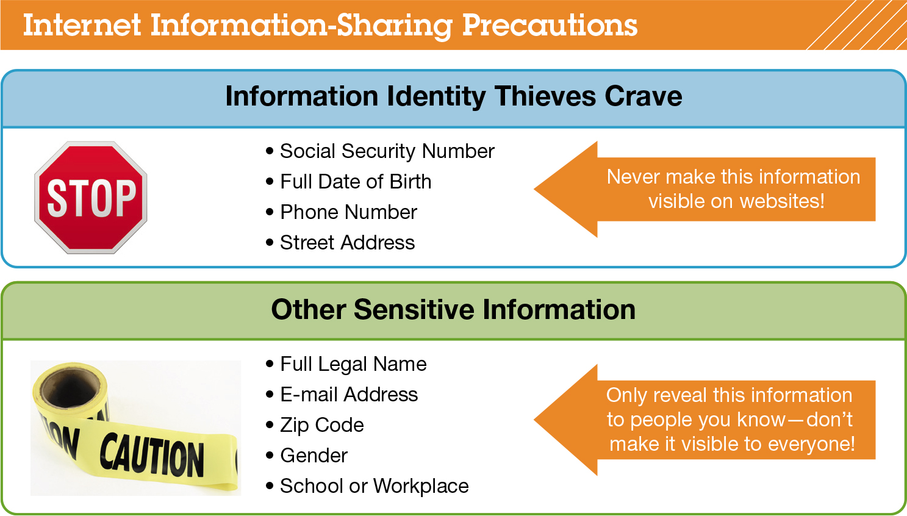
Keeping Your Data Safe: Protecting Your Personal Information
Notes:
Your Social Security number, phone number, date of birth, and street addresses are four key pieces of information that identity thieves need. This information should never be shared in public areas on any website.
Social networking sites like Facebook make privacy settings available in your profile settings.
To protect your information on Facebook, you need to change your privacy settings from some of the default options. It’s a bad idea to make personal information available to the public.
Restricting the information in the Contact section is imperative. You don’t want scammers contacting you via e-mail or mail.

Slide 61
Keeping Your Data Safe: Backing Up Your Data
Unauthorized access
Tampering
Destruction
Backups
Notes:
The data on your computer faces three major threats:
Unauthorized access
Tampering
Destruction
Because many things can happen that are beyond your control, you should have a strategy for backing up your files. Backups are copies of files that you can use to replace the originals if they’re lost or damaged.

Slide 62
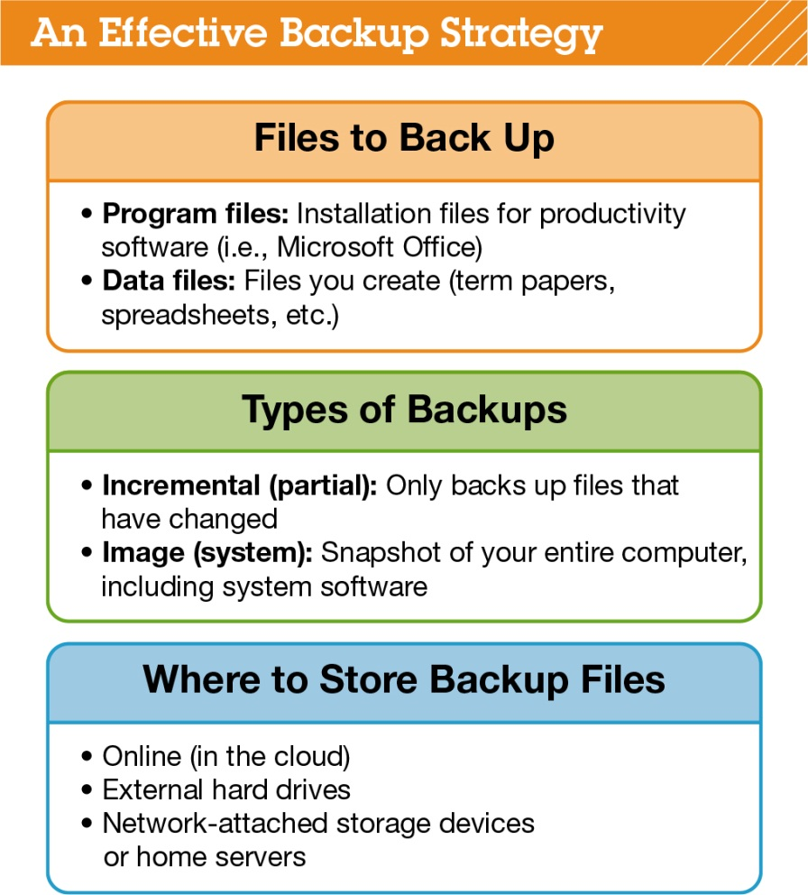
Keeping Your Data Safe: Backing Up Your Data (cont.)
Notes:
Two types of files need backups:
Program files include files used to install software, usually found on DVDs or downloaded from the Internet. As long as you have the DVDs in a safe place, you shouldn’t need to back up these program files. If you have downloaded a program file from the Internet, you should make a copy of the program installation files on a removable storage device.
Data files include files you’ve created or purchased, such as research papers, spreadsheets, music and photo files, contact lists, address books, e-mail archives, and your Favorites list from your browser.

Slide 63
Keeping Your Data Safe: Backing Up Your Data (cont.)
Options for backing up files
Incremental backup (partial backup)
Image backup (system backup)
Notes:
There are two main options for backing up files:
An incremental backup (or partial backup) involves backing up only files that have changed or been created since the last backup was performed.
An image backup (or system backup) means that all system, application, and data files are backed up, not just the files that changed.
Incremental backups are more efficient, an image backup ensures you capture changes to application files, such as automatic software updates, that an incremental backup might not capture.

Slide 64
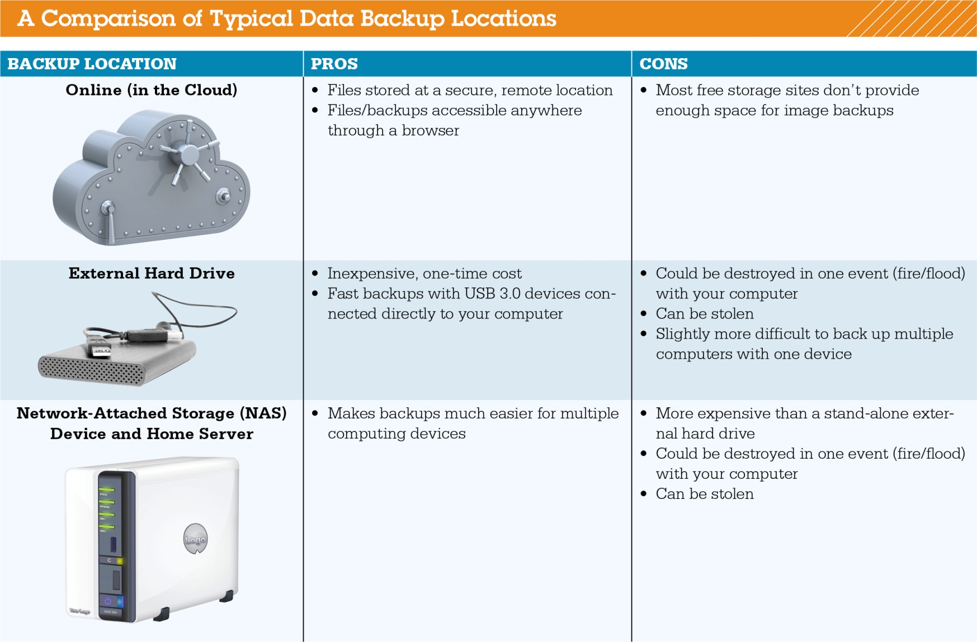
Keeping Your Data Safe: Backing Up Your Data (cont.)
Notes:
To be truly secure, backups must be stored away from where your computer is located and should be stored in at least two different places.
You have three main choices for where to back up your files:
Online (in the cloud).
External hard drives.
Network-attached storage (NAS) devices and home servers.
Most backup software can be configured to do backups automatically.

Slide 65
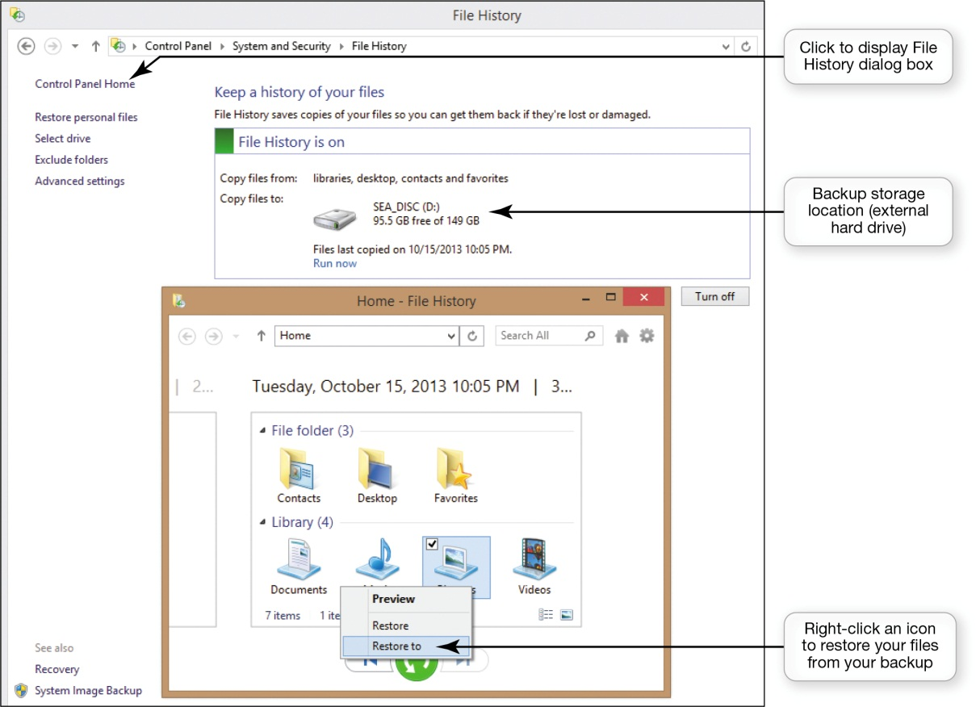
Keeping Your Data Safe: Backing Up Your Data (cont.)
Windows 8 includes the Windows 7 File Recovery utility
Notes:
Windows 8 includes the System Image Backup utility, which provides a quick and easy way to schedule regular image backups. You can access the utility from the System Image Backup link on the File History screen.
You can use the Windows 8 File History utility to back up files and restore files from a previous backup.
Access the Control Panel, select the System and Security group, and then click the File History link.

Slide 66
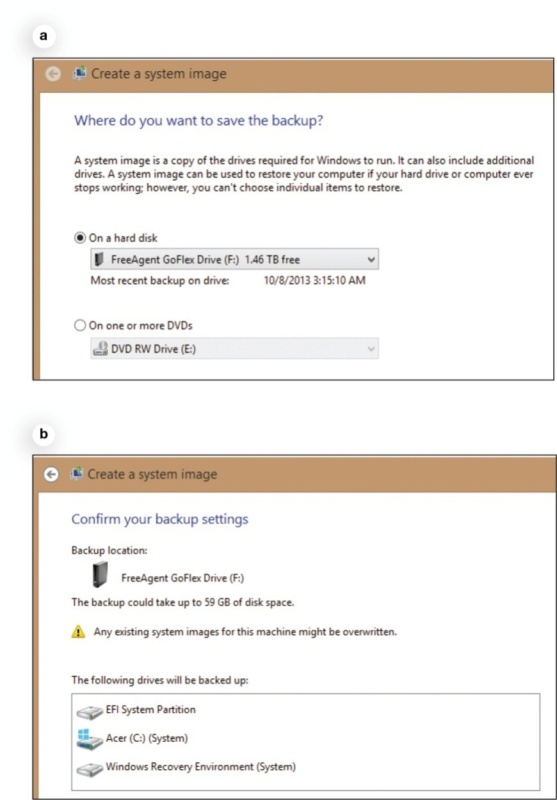
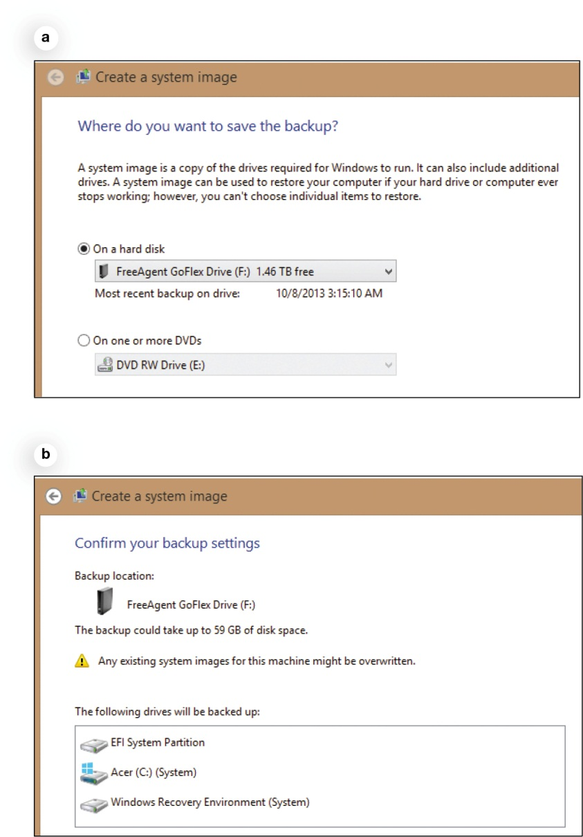
Keeping Your Data Safe: Backing Up Your Data (cont.)
Notes:
Before starting System Image Backup utility, make sure your external hard drive or NAS device is connected to your computer or network and is powered on. Follow these steps:
Select a backup device and click Next.
Review your settings on the next screen. Windows decides what to include in your system image backup: all data files and system files on all partitions on your hard drive. When you click the Start Backup button, your system image backup is created on the drive you selected.

Slide 67
Social Engineering
Human interaction to learn information
Pretexting
Fake phone call
Notes:
Social engineering is any technique that uses social skills to generate human interaction that entices individuals to reveal sensitive information.
Pretexting involves creating a scenario that sounds legitimate so people will trust you.
For example, you might receive a phone call during which the caller says he is from your bank and that someone tried to use your account without authorization. The caller then tells you he needs to confirm a few personal details. The information obtained can then be used commit some form of fraud. The most common form of pretexting in cyberspace is phishing.

Slide 68
Social Engineering: Phishing and Pharming
Phishing
Pharming
Notes:
Phishing (pronounced “fishing”) lures Internet users to reveal personal information that could lead to identity theft.
The scammers send e-mail messages that look like they’re from a legitimate business. The e-mail usually states that the recipient needs to update or confirm information. When the recipient clicks the link, he or she goes to a website that looks legitimate but is really a copy. Once the recipient enters his or her personal information, the scammers capture it and can begin using it.
Pharming occurs when malicious code is planted on your computer which alters your browser’s ability to find web addresses.

Slide 69
Social Engineering: Phishing and Pharming (cont.)
Guidelines to avoid schemes
Never reply directly to e-mails asking for personal information
Don’t click on links in e-mails
Never give personal information over the Internet unless the site is secure
Use phishing filters
Use Internet security software
Notes:
Follow these guidelines to avoid schemes:
Never reply directly to any e-mail asking you for personal information.
Don’t click on a link in an e-mail to go to a website. Instead, type the website address in the browser.
Check with the company asking for the information and only give the information if you’re certain it’s needed.
Never give personal information over the Internet unless you know the site is secure. Look for the closed padlock, https, or a certification seal to help reassure you that the site is secure.
Use phishing filters.
Use Internet security software that’s constantly being updated.

Slide 70
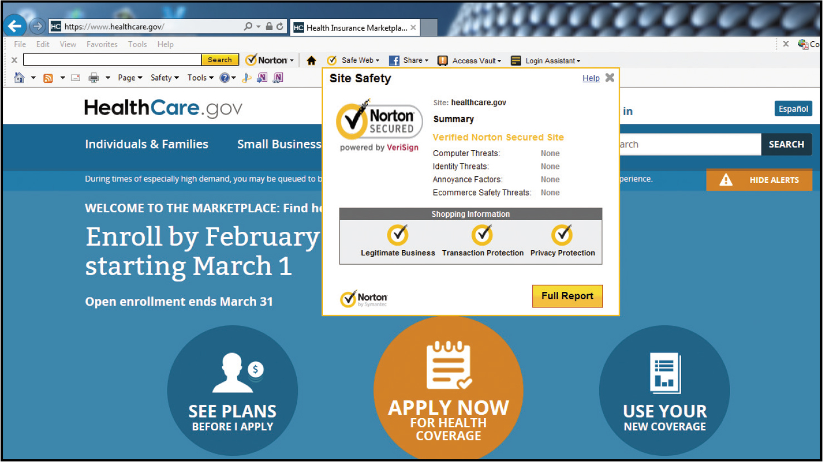
Social Engineering: Phishing and Pharming (cont.)
Notes:
Most Internet security packages can detect and prevent pharming attacks. The major Internet security packages—for example, McAfee and Norton—also offer phishing protection tools.
When you have the Norton Toolbar displayed in your browser, you’re constantly informed about the legitimacy of the site you are visiting.

Slide 71
Social Engineering: Scareware
Type of malware
Pop-ups
Banners
Annoying types of messages
Notes:
Scareware is a type of malware that’s downloaded onto your computer and tries to convince you that your computer is infected with a virus or other type of malware. Pop-ups, banners, or other annoying types of messages will flash on your screen saying things like, “Your computer is infected with a virus! Immediate removal required.”
You’re then directed to a website where you can buy fake removal or antivirus tools.
Scareware is a social engineering technique because it uses people’s fear of computer viruses to convince them to part with their money.

Slide 72
Protecting Your Physical Computing Assets: Environmental Factors
Level surface
Protective case
Don’t leave in a car in extreme temperatures
Chill mats
Keep intake vent unblocked
Keep room clean
Don’t eat or drink near your computer
Notes:
You should make sure that your computer sits on a flat, level surface, and if it’s a laptop or a tablet, you should carry it in a protective case.
Don’t leave computing devices and phones in a car during especially hot or cold weather because components can be damaged by extreme temperatures.
Chill mats are useful accessories for dissipating heat.
Make sure that you place your desktop computer where the fan’s intake vents are unblocked.
Keep the room in which your computer is located as clean as possible.
Don’t consume food and beverages near your computer.

Slide 73
Protecting Your Physical Computing Assets: Power Surges
Power surges
Old or faulty wiring
Downed power lines
Malfunctions at electric company substations
Lightning strikes
Surge protector
Replace every two – three years
Use with all devices that have solid-state components
Notes:
Power surges occur when an electrical current is supplied in excess of normal voltage. Old or faulty wiring, downed power lines, malfunctions at electric company substations, and lightning strikes can all cause power surges.
A surge protector is a device that protects your computer against power surges.
You should replace your surge protectors every two – three years. After a major surge, the surge protector will no longer function and must be replaced.
All electronic devices in the home that have solid-state components should be connected to a surge protector. A whole-house surge protector protect all electrical devices in the house.

Slide 74
Protecting Your Physical Computing Assets: Deterring Theft
Security concerns with mobile devices
Keeping them from being stolen
Keeping data secure in case they are stolen
Finding a device if it is stolen
Remotely recovering and wiping data off a stolen device
Notes:
Because they’re portable, laptops, tablets, and smartphones are easy targets for thieves. You have four main security concerns with mobile devices:
Keeping them from being stolen
Keeping data secure in case they are stolen
Finding a device if it is stolen
Remotely recovering and wiping data off a stolen device

Slide 75
Protecting Your Physical Computing Assets: Keep Them Safe: Alarms
Motion alarm software
LAlarm: free software for laptops
SuperAlarm and Alarmomatic
Notes:
Motion alarm software is a good inexpensive theft deterrent. Free software such as LAlarm is effective for laptops. Apps such as Motion Alarm and Alarmomatic help secure your iPad or iPhone.
Alarm software detects motion, like your device being picked up, then sets off an ear-piercing alarm until you enter the disable code.

Slide 76
Protecting Your Physical Computing Assets: Keeping Mobile Device Data Secure
Encrypt data on your mobile device
Transform data using an algorithm that can only be unlocked by a secure code (or key)
Safe: an app that provides 256-bit encryption
SensiGuard and SafeHouse
Notes:
Encrypting the data on your mobile device can make it extremely difficult for thieves to obtain sensitive data from your stolen equipment. Encryption involves transforming your data using an algorithm that can only be unlocked by a secure code (or key).
Safe is an app that provides 256-bit encryption for data on your iPhone or iPad. If your password is not entered, no one can access the data and images on your iPhone or iPad. Mobile StrongBox is a similar app for Android devices.
SensiGuard and SafeHouse are available for laptops to provide encryption for files or hard drives.

Slide 77
Protecting Your Physical Computing Assets: Software Alerts and Data Wipes
Theft-tracking software
Computrace LoJack for Laptops
PC PhoneHome
MacPhoneHome
Remote recovery and deletion of files
LoJack for Laptops
Notes:
Tracking software such as Computrace LoJack for Laptops, PC PhoneHome, and MacPhoneHome enables your computer to alert authorities to the its location if it is stolen. iHound is an app for Android and iOS devices.
In the event that your laptop can’t be recovered, software packages are available that provide for remote recovery and deletion of files. LoJack for Laptops has these features and allows you to lock your device to keep the thieves from accessing it or remotely wipe its contents by deleting all your data from your laptop.

Slide 78
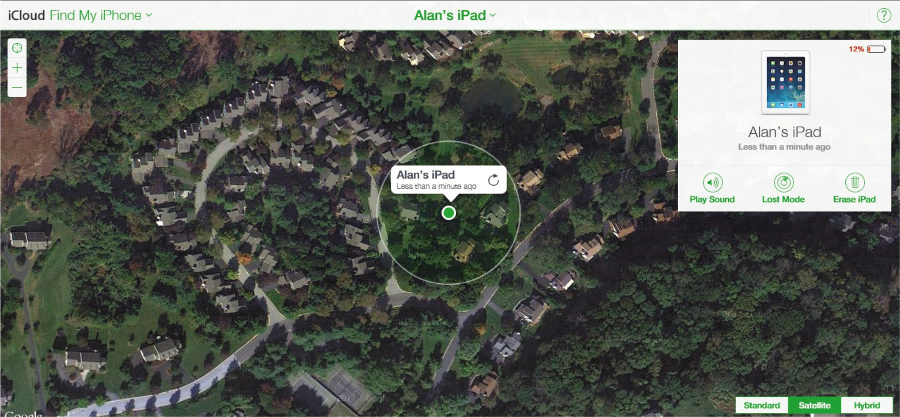
Protecting Your Physical Computing Assets: Software Alerts and Data Wipes (cont.)
Notes:
For all iOS devices, Apple offers the Find My iPhone service. Enabling this service provides you with numerous tools that can assist in recovering and protecting your devices.
If you forget where you left your iPad just sign in with your Apple ID at the iCloud website to see a map showing the location of your iPad. You can remotely send a message to be displayed on your lost device so that someone who finds it will know what to do. If you can’t recover the device, you can remotely password lock it or wipe all the data.

Slide 79
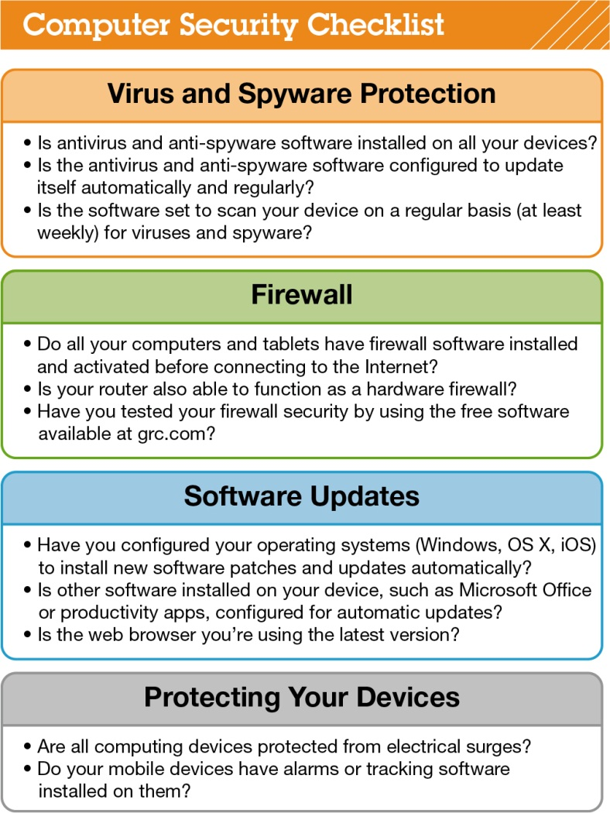
Protecting Your Physical Computing Assets: Software Alerts and Data Wipes (cont.)
Notes:
The checklist shown is a guide to ensure you haven’t missed any critical aspects of security. If you’ve addressed all these issues, then you can feel reasonably confident that your digital data and devices are secure.

Slide 80
Chapter 9 Summary Questions
What is cybercrime and who perpetrates it?
Notes:
Cybercrime is any type of crime perpetrated via a computer or a website. Major types of cybercrime are identity theft, credit card fraud, computer viruses, illegal access of computer systems, and auction fraud. Cybercriminals use computers, the Internet, and computer networks to commit their crimes.

Slide 81
Chapter 9 Summary Questions
What are the types of viruses from which I need to protect my computer?
Notes:
A computer virus is a program that attaches itself to another program and attempts to spread to other computers when files are exchanged. Computer viruses can be grouped into six categories: (1) boot-sector viruses, (2) logic bombs and time bombs, (3) worms, (4) scripts and macro viruses, (5) e-mail viruses, and (6) encryption viruses. Once run, viruses perform their malicious duties in the background and are often invisible to the user.

Slide 82
Chapter 9 Summary Questions
What can I do to protect my computer from viruses?
Notes:
The best defense against viruses is to install antivirus software. You should update the software on a regular basis and configure it to examine all e-mail
attachments for viruses. You should periodically run a complete virus scan on your computer to ensure that no viruses have made it onto your hard drive.

Slide 83
Chapter 9 Summary Questions
How can hackers attack my computing devices, and what harm can they cause?
Notes:
A hacker is defined as anyone who breaks into a computer system unlawfully. Hackers can use software to break into almost any computer connected to the Internet, unless proper precautions are taken. Once hackers gain access to a computer, they can potentially (1) steal personal or other important information, (2) damage and destroy data, or (3) use the computer to attack other computers.

Slide 84
Chapter 9 Summary Questions
What is a firewall, and how does it keep my computer safe from hackers?
Notes:
Firewalls are software programs or hardware devices designed to keep computers safe from hackers. By using a personal firewall, you can close
to invaders open logical ports and potentially make your computer invisible to other computers on the Internet.

Slide 85
Chapter 9 Summary Questions
How do I create secure passwords and manage all of my passwords?
Notes:
Secure passwords contain a mixture of upper- and lowercase letters, numbers, and symbols and are at least 14 characters long. Passwords should not contain words that are in the dictionary or easy-to-guess personal information, like your pet’s name. Online password checkers can be used to evaluate the strength of your passwords. Utilities built into web browsers and Internet security software can be used to manage your passwords and alleviate the need to remember numerous complex passwords.

Slide 86
Chapter 9 Summary Questions
How can I surf the Internet anonymously and use biometric authentication devices to protect my data?
Notes:
The current versions of popular browsers include tools, such as Google Chrome’s Incognito feature, that hide your surfing activities by not recording
websites that you visit or files that you download in your browser’s history files. Biometric authentication devices use a physical attribute that is not easily duplicated to control access to data files or computing devices. Some laptops and smartphones today feature fingerprint readers and facial-recognition software to control access.

Slide 87
Chapter 9 Summary Questions
How do I manage online annoyances such as spyware and spam?
Notes:
The web is filled with annoyances such as spam, pop-ups, cookies, spyware, and scams such as phishing that make surfing the web frustrating and sometimes dangerous. Installing anti-malware software tools helps to prevent, detect, and/or reduce spam, adware, and spyware.

Slide 88
Chapter 9 Summary Questions
What data do I need to back up, and what are the best methods for doing so?
Notes:
Data files you create or purchase need to be backed up in case they’re deleted or damaged. Application software may need to be reinstalled if files are damaged, so backups must be maintained. An incremental backup means only files that have changed or been created since the last backup will be backed up. Image backups copy all system, application, and data files regardless of whether they changed since the last backup. Websites such as ADrive and OneDrive are great for backing up individual files. External hard drives are popular choices for holding image backups, as are online storage sites.

Slide 89
Chapter 9 Summary Questions
What is social engineering, and how do I avoid falling prey to phishing?
Notes:
Social engineering schemes use human interaction, deception, and trickery to fool people into revealing sensitive information. Phishing schemes usually involve e-mails that direct the unwary to a website that appears to be legitimate, such as a bank site, but that is specifically designed to capture personal information for committing fraud. To avoid phishing scams, you should never reply directly to any e-mail asking you for personal information and never click on a link in an e-mail to go to a website. Don’t fall for scareware scams that attempt to frighten you by pretending there is something wrong with your computer.

Slide 90
Chapter 9 Summary Questions
How do I protect my physical computing assets from environmental hazards, power surges, and theft?
Notes:
Computing devices should be kept in clean environments free from dust and other particulates and should not be exposed to extreme temperatures. You should protect all electronic devices from power surges by using surge protectors, which will protect them from most electrical surges that could damage the devices. Mobile devices can be protected from theft by installing software that will (1) set off an alarm if the computer is moved; (2) help recover the computer, if stolen, by reporting the computer’s whereabouts when it is connected to the Internet; and/or (3) allow you to lock or wipe the contents remotely.

Slide 91
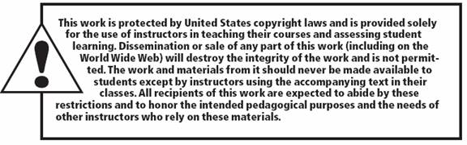
All rights reserved. No part of this publication may be reproduced, stored in a retrieval system, or transmitted, in any form or by any means, electronic, mechanical, photocopying, recording, or otherwise, without the prior written permission of the publisher. Printed in the United States of America.
Copyright © 2015 Pearson Education, Inc.

